Slide 1
Background
The COVID-19 pandemic:
impacted heavily on education and training systems;
accelerated digital transformation;
triggered rapid, large-scale change.
This pandemic exposed the need to:
integrate digital technologies in training;
rethink how training is designed and provided.
It highlighted the need for trainers and VET staff to be more confident and skilled in using digital technology.
AGILE-2-VET project has been structured on these preconditions, reported by the European Commission in the new Digital Education Action Plan 2021-2027.
Notes:
The COVID-19 pandemic impacted heavily on education and training systems and has accelerated the digital transformation and triggered rapid, large-scale change.
This pandemic exposed the shortcomings that need to be tackled to successfully integrate digital technologies in training systems and requires to rethink how training, in all disciplines, is designed and provided to meet the demands of a rapidly changing and increasingly digital world, considering how all phases of training processes can purposefully and strategically embed digital technologies into educational practices.
It has emerged as a key enabling factor for effective digital training, among others, the NEED FOR TRAINERS AND VET STAFF IN GENERAL TO BE MORE CONFIDENT AND SKILLED IN USING DIGITAL TECHNOLOGY to support their teaching and adapted pedagogy and be prepared to collaboration and the sharing of good practice and innovative teaching methods.
AGILE-2-VET project has been structured on these preconditions, reported by EC in the new Digital Education Action Plan 2021-2027, wishing to meet the general objective of contributing to the innovation of VET sector by strengthening the capacity of VET providers to deliver inclusive and high-quality digital education, focusing on developing the ability to implement online, blended and distance teaching and learning in collaboration with digital technology providers and experts in educational technologies and pedagogical practices.

Slide 2
The Partners
7 Partners from 5 EU Countries
Universities, Education Institutions, VET Facilitators and Digital Learning Designers
Italy
Germany
Sweden
Spain
Ireland
This Photo by Unknown Author is licensed under CC BY
This Photo by Unknown Author is licensed under CC BY-SA
This Photo by Unknown Author is licensed under CC BY-SA

Slide 3
Objectives
The AGILE-2-VET objectives move along two strategic lines:
To develop the skills of staff of VET providers, specifically trainers and tutors, in relation to the transition from face-to-face to remote training.
To strengthen the collaboration between training institutions and companies providing digital technology and experts in educational and pedagogical practices and to structure training design models that can be used in the context of professional distance/online training, primarily aimed at adults and workers, useful for the development of innovative training proposals in digital / e-learning format.

Slide 4
Project Steps
Project activities have been be divided into 3 steps that will generate 3 main results:
Step 1: Analysis (Result 1)
Desk and field research to define the key features of online/distance learning and related competencies for VET staff.
Step 2: Training model development (Result 2)
Defined competencies, structured training programme and methodologies, addressed to increase competencies to foster the acquisition of a digital cultural approach in VET.
Step 3: AGILE-2-VET experimentation and Manual (Result 3)
Testing the digital toolkit designed to support VET staff /professionals working in adult education acquire relevant skills and competencies needed to provide high-quality and inclusive adult training.

Slide 5
Step 1: Analysis
Results were produced through the following stakeholder input:
Ireland Online Survey
Sweden Group Discussion
Spain Group Discussion
Italy Group Discussion
Germany Disseminated Results

Slide 6
Step 1: Analysis –Skills Data
Ireland
Spain
Italy
Sweden
Diversity & Inclusion
Diversity & Inclusion
Diversity & Inclusion
Training Needs Analysis
Engagement
Collaboration
Clear Objectives
Make Virtual Interesting
Feedback Driven
Interactive Content
Bringing New Ideas and Concepts
Adapting
Analysing
Collaboration
Measuring Impact
Make Learning Transformative
Technology capability
Engagement with mobile Learners
Empathy to Manage Learners needs
Digital Content Ability
Competence in Worksheets
Creating Work Groups
Flexibility
Innovative Content
Collaboration
Learners Needs
More engagement between developers and Teachers
Digital Pace
Evaluate
Evaluate
Evaluate

Slide 7
Step 1: Analysis - Research on Methodologies
All partners make use of a series of learning/holistic models as an inspiration and as guidelines to action, including prior planning with structural elements
ADDIE
AGILE
ADDIE has been criticized for being too inflexible and too linear.
SAM solves the problem of inflexibility: it is a simplified version of ADDIE designed to elicit feedback, improving the product in iterative loops.
MERRILS PRINCIPLES
SYSTEMS
APPROACH MODEL
The Kemp model’s approach is circular, indicating the interdependency among all core elements.
The Agile Methodology shows VET programs must remain flexible despite following a given framework, which inevitably creates a tension
between flexibility and rigidity
SAM
SUCCESSIVE
APROXIMATION MODEL
KEMP

Slide 8
Step 2: Training Model Development
Emerging from the primary data (focus groups and surveys) and secondary data (the examined learning/holistic models), the creation of a holistic VET online program the “Agile-2-VET Holistic Digital Training Model”.
It includes precise steps (design, implementation and evaluation) with a constantly open feedback channel. In a sense, a VET online program is an adaptive system, altering its components as a result of iterative feedback loops.
The proposed model also reinforces the need for constant evaluation, a process in which all partners already thoroughly engage
Design
Implementation
Evaluation

Slide 9
Agile-2-VET Holistic Digital Training Model
Evaluation
Delivery
Design
Planning
The VET sector comprises of a mix of cohorts including:
Facilitators
Teachers
Designers
Stakeholders
Adding a 4th “Planning” component to the Agile-2-VET Holistic Digital Training Model provides opportunity to build collaboration, engagement and understanding of training needs, highlighted in the data as important to the success of design and development of training content.

Slide 10
Where Are We Now?
The objective of Agile-2 VET is to develop skills and strengthen collaboration.
To achieve this outcome, in a constantly transformative digital environment, there is a need to understand real-time levels of digital competency, knowledge and skills.
With the various cohorts within the VET sector and based on the data, competencies were selected that support an individuals ability to adapt to a changing digital learning environment.
These 4 competencies are Resilience, Perception, Flexibility and Autonomy.
Perception
Flexibility
Autonomy
Resilience
Competencies:

Slide 11
Resilience
Resilience is the ability to adapt and adjust to change and to reach a positive outcome.
Being resilient enables you to bounce back from negativity. Resilience applies when you are adapting to an environment which has unfamiliar routines or processes or you are removed from a team environment to an isolated situation.
In the Digital Learning environment being resilient enables you to navigate digital transformation confidently by understanding your level of digital skills and how you can develop them. Creating a safe, comfortable and inclusive learning environment builds resilience.

Slide 12
Perception
Perception is how we see, hear or understand something. It is your human radar and how you perceive things.
In the Digital Learning environment there is a need to focus on the context of the communication, communicate accurately and interpret information objectively. The digital learning environment can lead to perceiving problems when communicating with others that do not exist. Collaboration is important to know who you need to engage with and what support or resources are available.

Slide 13
Flexibility
Flexibility requires and individual to be flexible in their approach and open to change.
In the Digital Learning environment it is important to recognise that you need to be open to how others communicate, whether they are learners, facilitators, designers or stakeholders. Think about the different styles of communication needed to optimise engagement with others. Without the benefit of physical presence you need to be tolerant and open to virtual body language.

Slide 14
Autonomy
With personal autonomy you have control over your work and delivering on expectations.
In the Digital Learning environment you will need to take responsibility for your actions and respect others. Being autonomous increases motivation and satisfaction in reaching the desired outcomes.
Evaluating outcomes, achieving set goals and knowing what worked and what does not work is autonomous to you and enables you to evaluate effectively.

Slide 15
Mapping the Content
Perception
Flexibility
Autonomy
Resilience
Competencies:
Self-reflection / self-assessment tool
Containing a series of questions that align to the Agile2VET training model and the identified digital competencies and skills needed for online learning in the VET sector.
Microlearning
A set of digital resources, including links to open education resources, that align to the areas defined in the Agile2VET training model.
Learners can select resources based on their training needs/skills-gaps identified through the self-reflection tool.
Planning
Design
Delivery
Evaluation

Slide 16
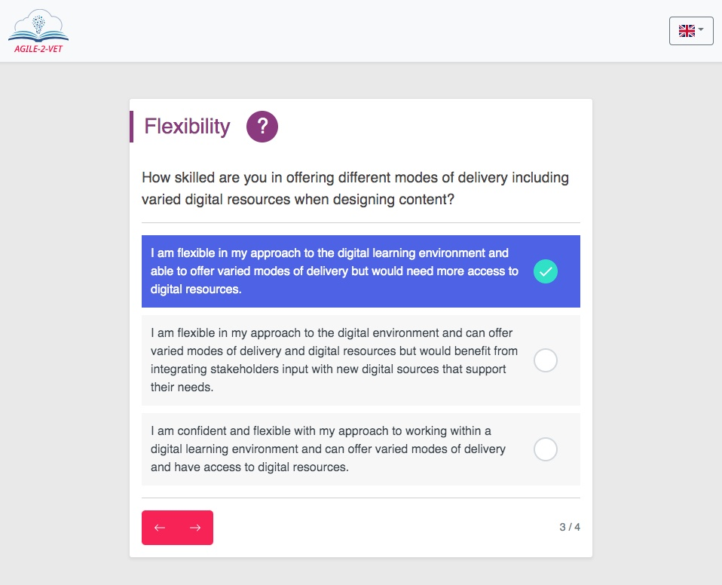
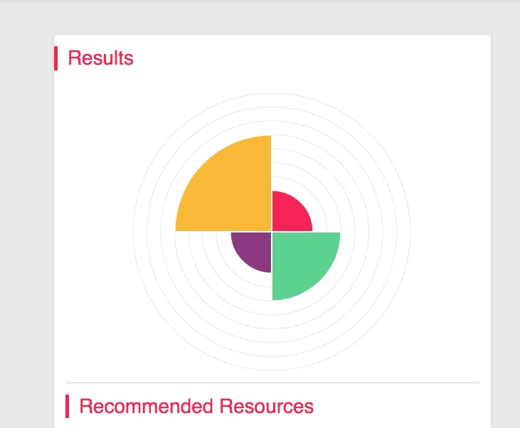
Step 3: Experimentation
Testing the digital toolkit.

Slide 17
Any Questions?

